Slide 1





By: Jerry Contreras
Database Systems and Physical Design:
Final Project

Slide 2











Technologies Used

Slide 3
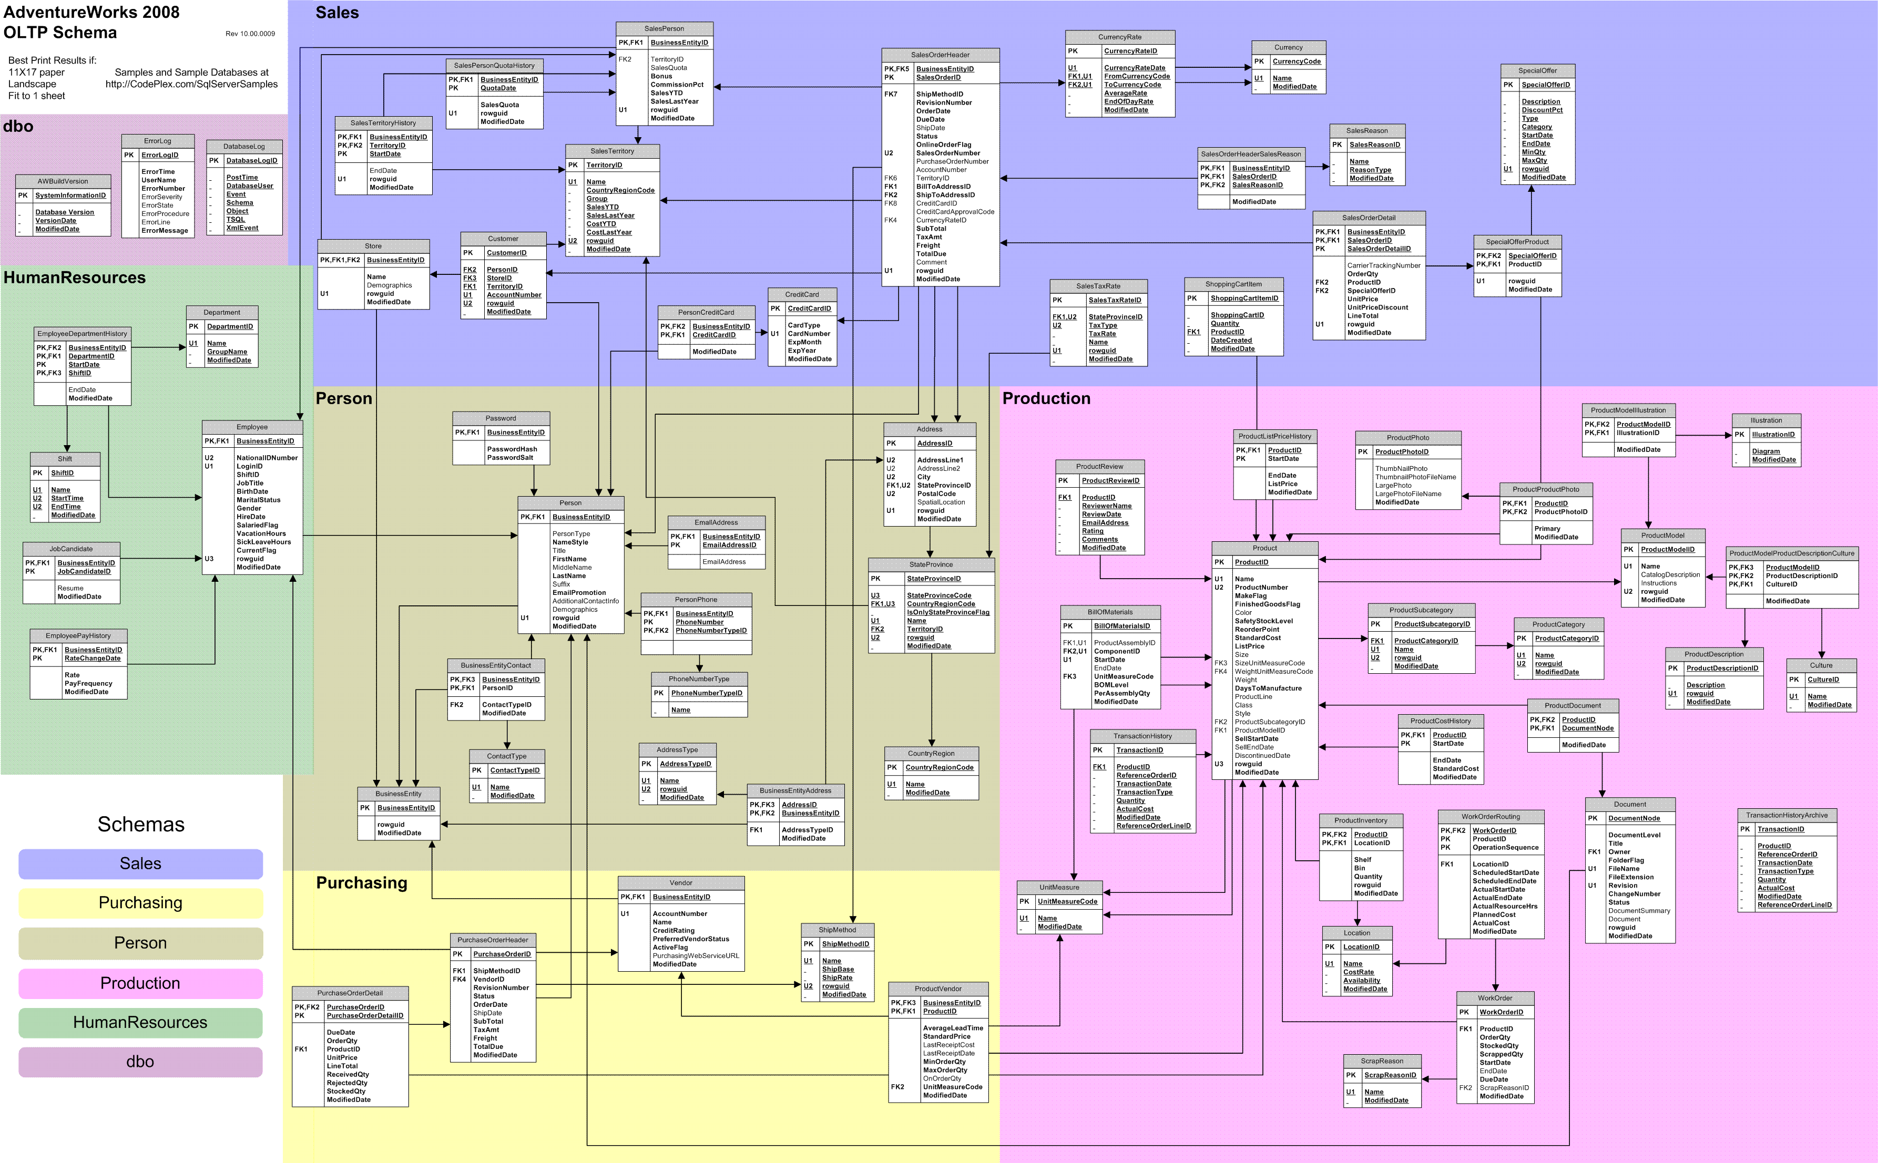
AdventureWorks
Database
For simplicity sake, let’s only focus on what is in the red

Slide 4
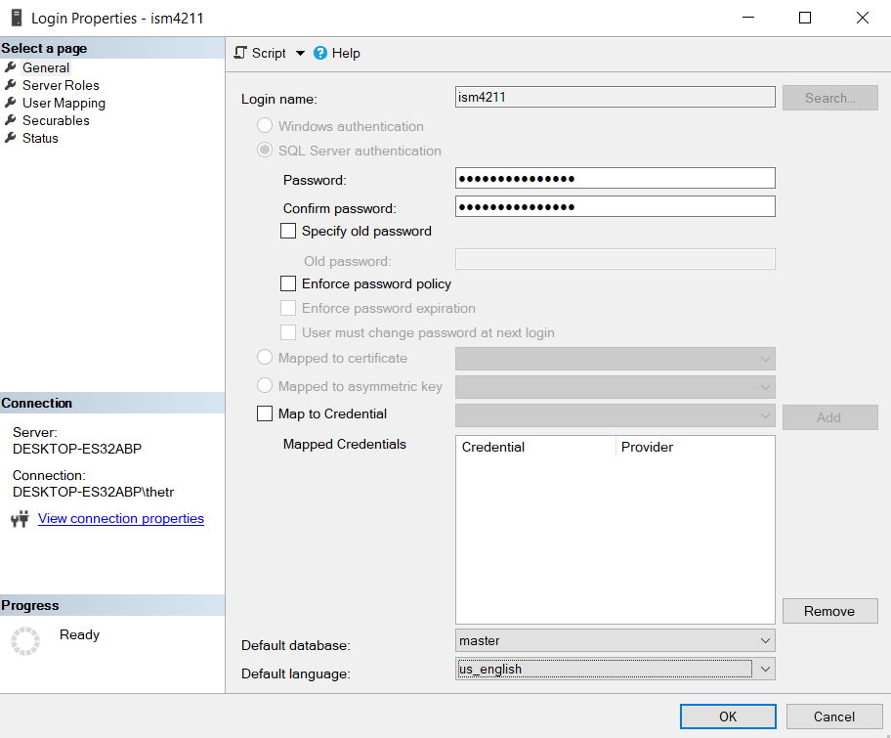

Step 1: Create a login - Python needs to connect to the database, it needs to have the necessary credentials to execute T-SQL Queries

Slide 5
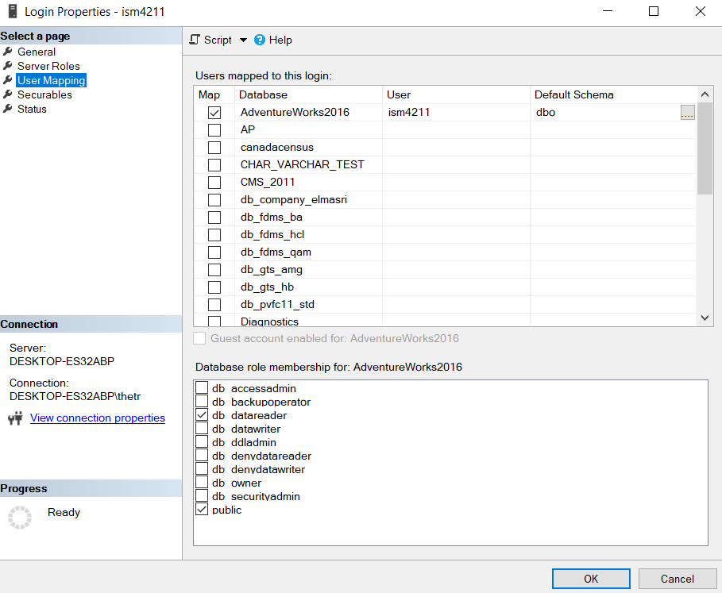



Step 2: Map Users to Database -Assigning the database this user will have access to - Assigning the reading rights, because we will not be doing any updates, deletes, create statements

Slide 6
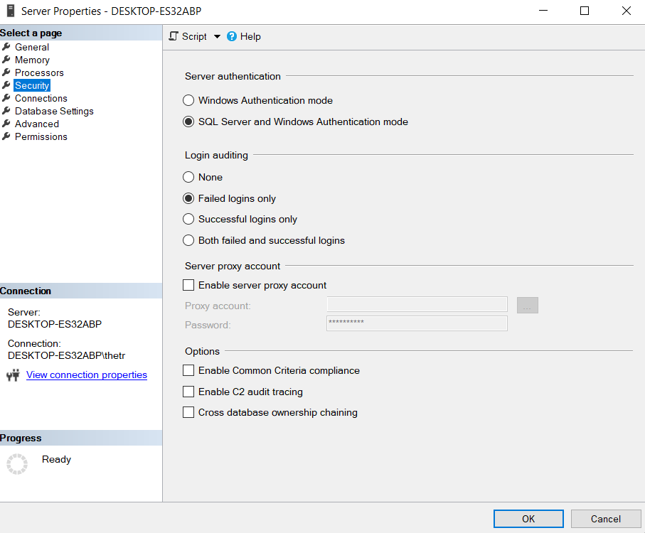
Step 3: Server Properties - Windows Authentication mode is the default, python will be login in with SQL Server Authentication mode, therefore switch the settings

Slide 7
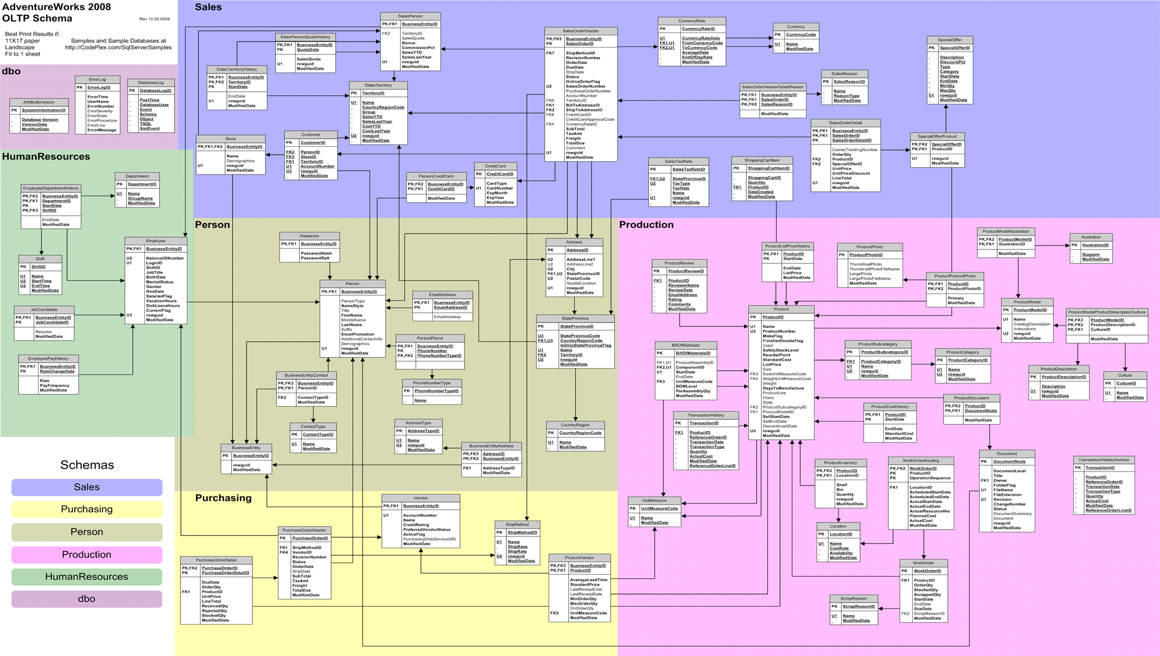
SQL Schema Mongo Schema
It would seem appropriate for the collections that will be created in MongoDB to be equal to the amount of schemas
Three Schema are mainly being utilized, so three collection must be made
2
1
3

Slide 8
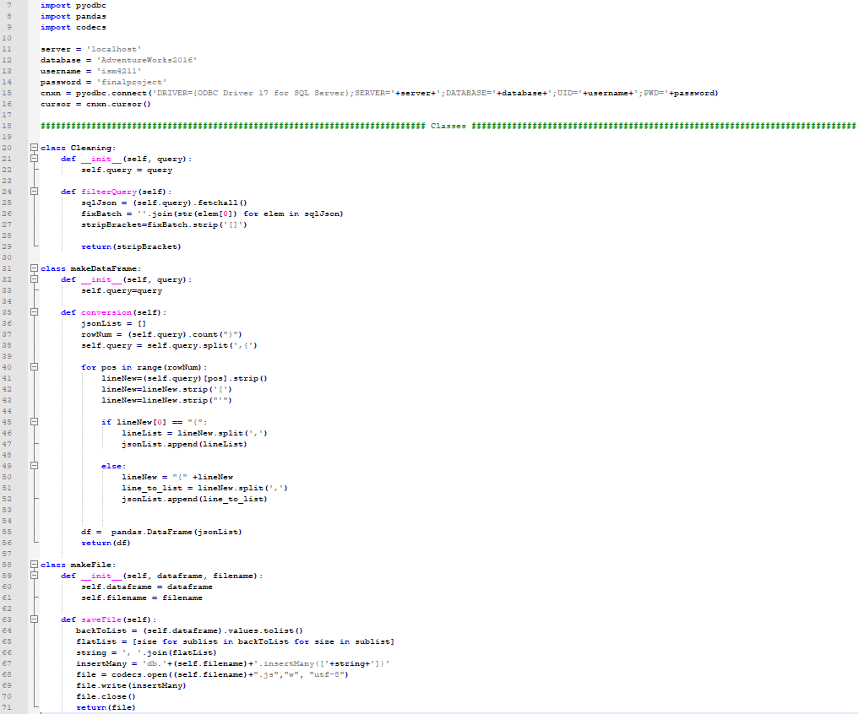

These are the packages that were used to execute this project, as well as the connection string used to connect to the local instance of Microsoft SQL Server
This class cleans the batched JSON string that is received by the pyodbc driver
This class separates elements in the JSON string and assigns it to list of lists, which get converted to a data frame
Before calling upon the makeFile class, distinct manipulation must be done to each query batch. Once that takes place, this save a JavaScript file in the working directory

Slide 9
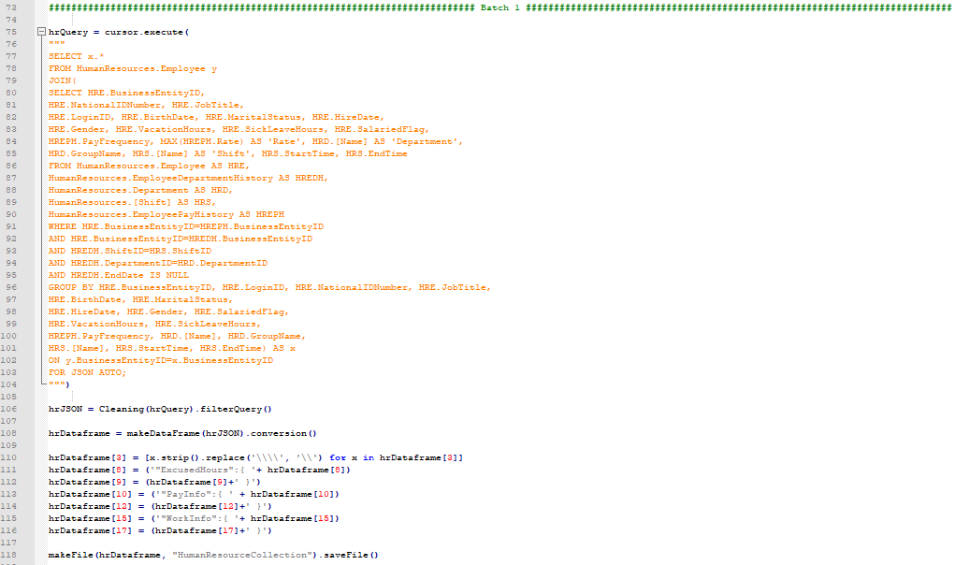
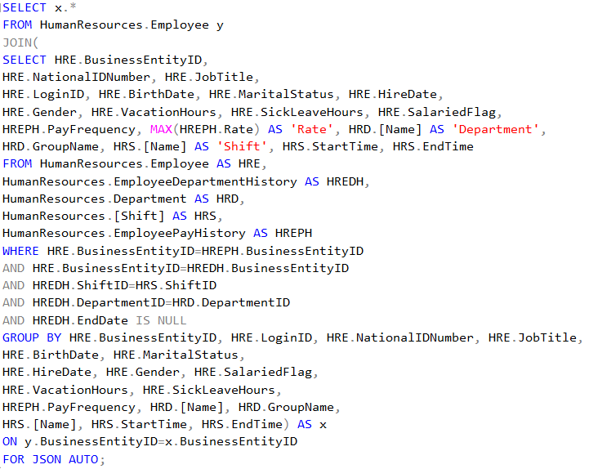
This is the query statement used to extract the data from the HumanResourceSchema to insert into the HumanResourceCollection, one interesting component about this query is that MAX to grab their most recent pay rate value for their employees, they kept a history a rate changes. Since we are transiting to a new information system, we will keep the current pay rate.
Distinct JSON Manipulation that need to be made for this query batch and then saves that variable through a class, and creates a JavaScript file

Slide 10
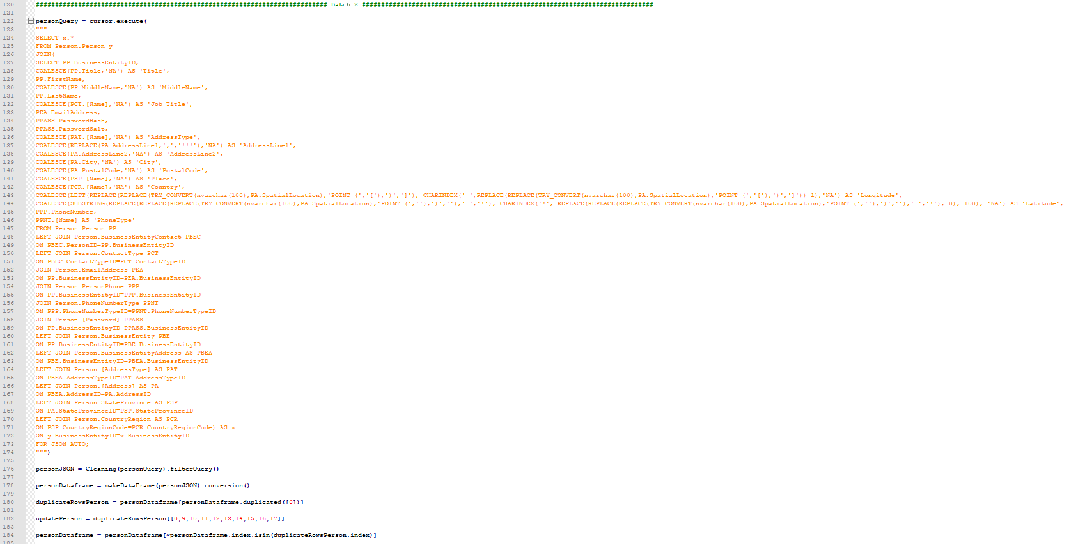
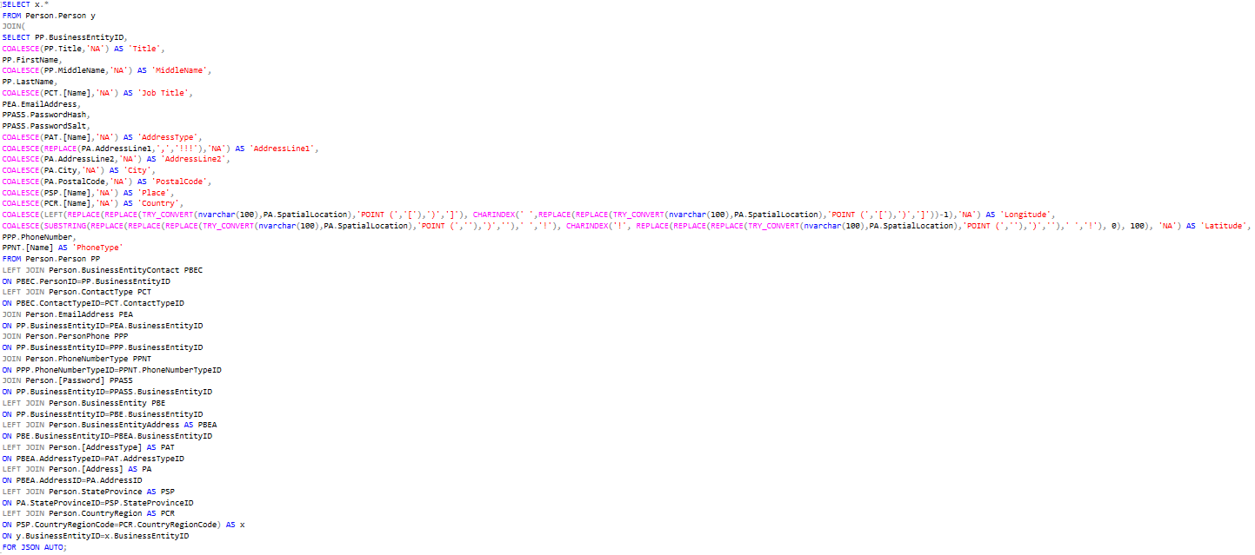
This was frustrating because I had null markers in Person.PersonSchema this was tampering with the saveFile class, for the solution to this the null markers were casted to physical values as “NA”
Some Addresses had commas in them so I also casted them to a “!”, and replaced later
This 2 long select statement were brutally painful, because there was Spatial Data stored in this format:
POINT (-34.4542325 74.56236566), to separate both values into their own respective columns and get rid of “POINT (“, on top of that this also had null markers
The nightmare about this part was there was duplicate data due to the fact that one person could have multiple addresses, therefore the entire row would be displayed but only have that field different. The fix to this was to isolate and create another file where I update the existing document in MongoDB

Slide 11

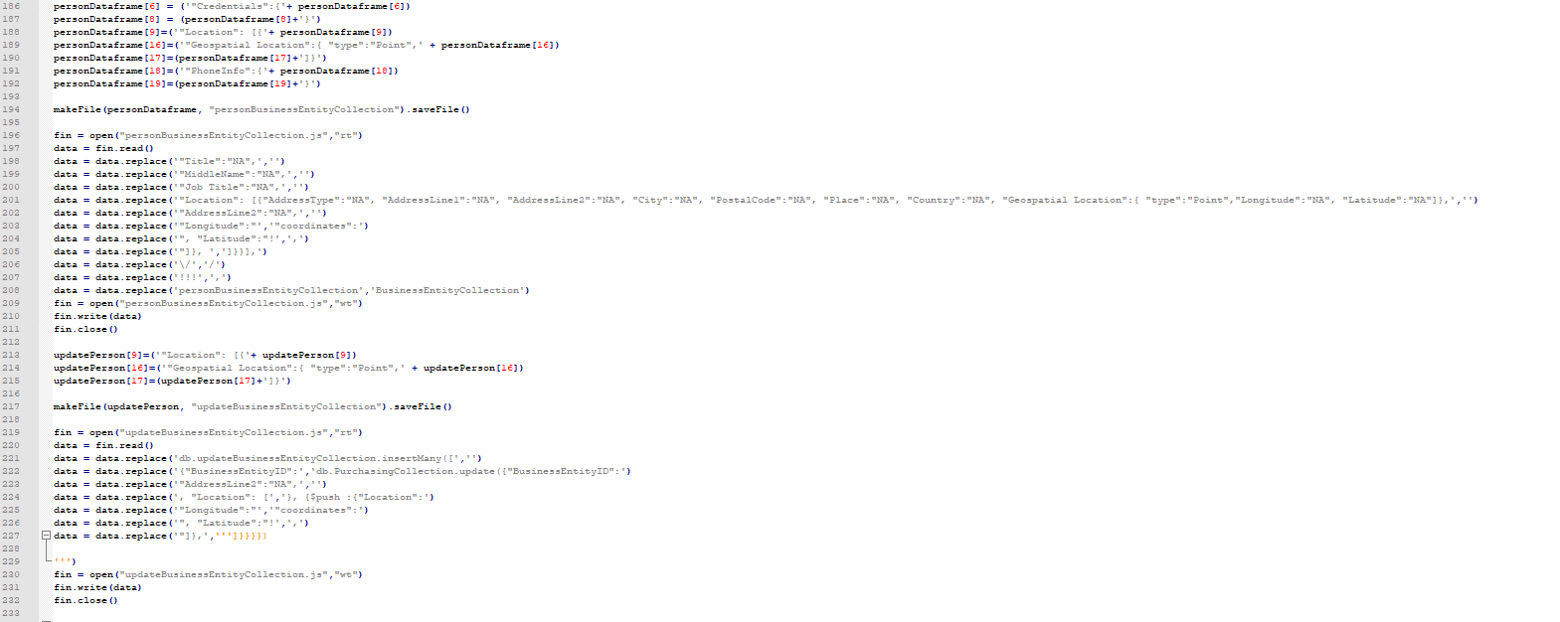
Have Perseverance
Find the individual string I have to alter for the proper JSON format, use same methodology for duplicates. AND THAT’S IT!!!!! everything else is rise and repeat

Slide 12
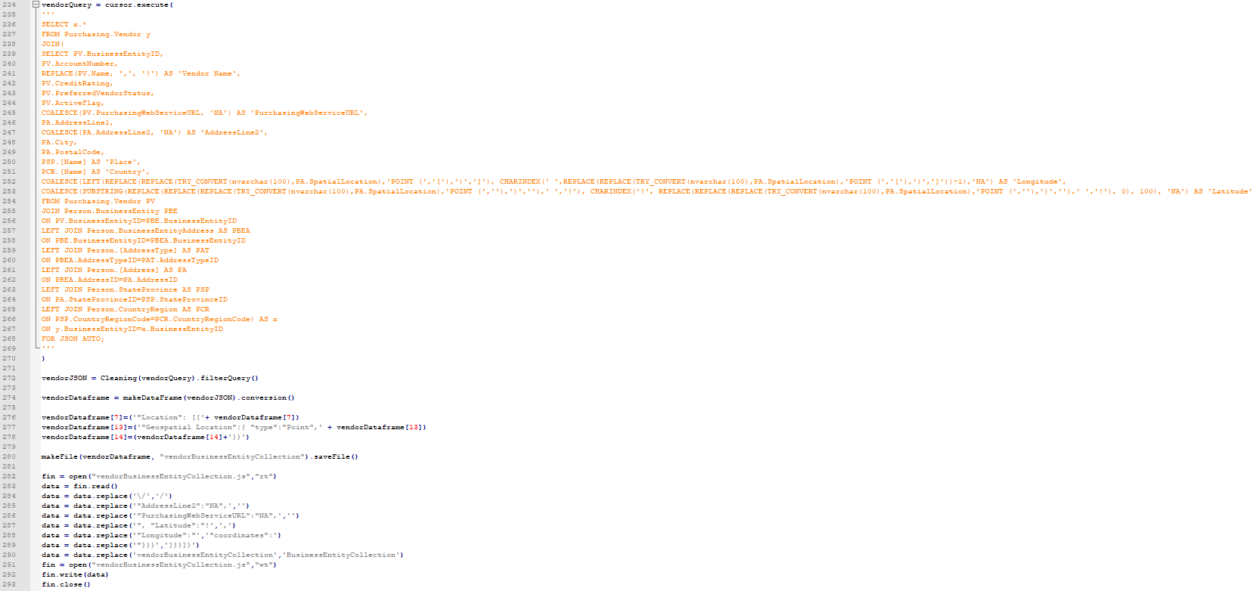
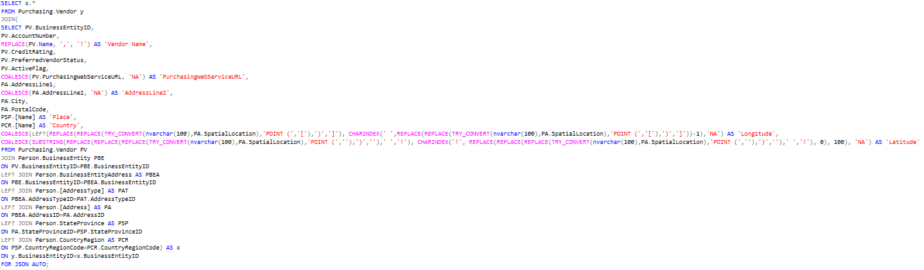
Rinse and Repeat

Slide 13
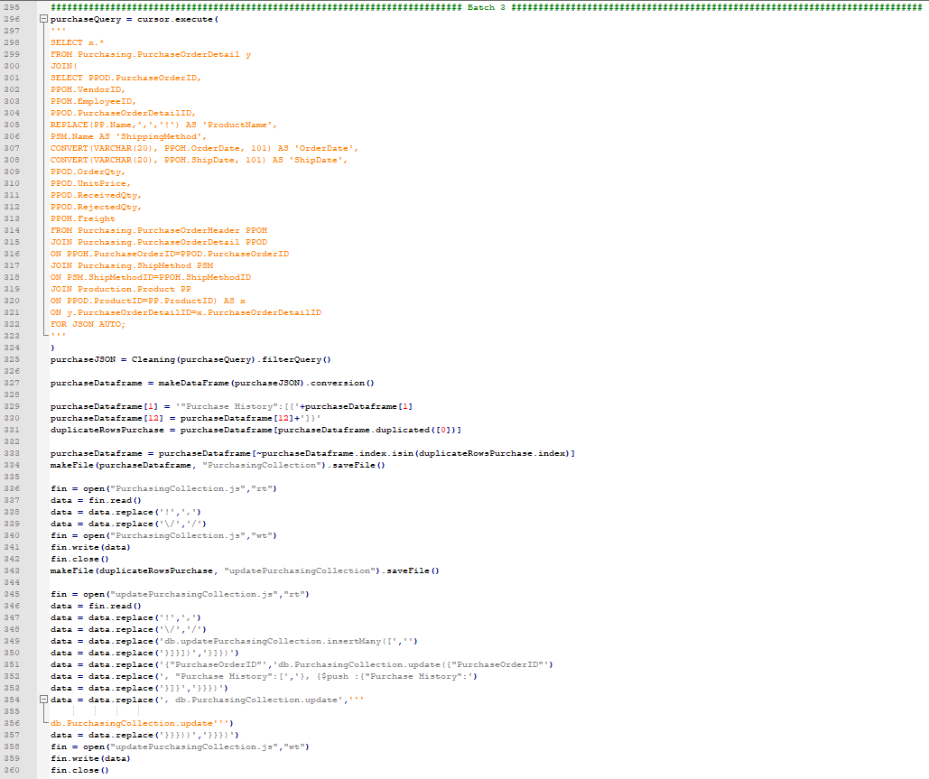
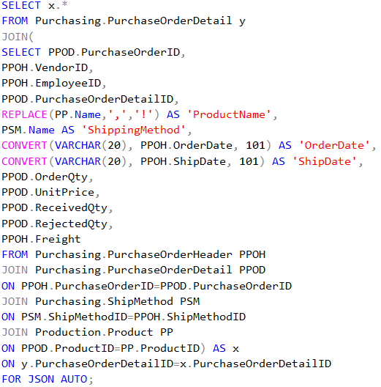
Rinse and Repeat

Slide 14
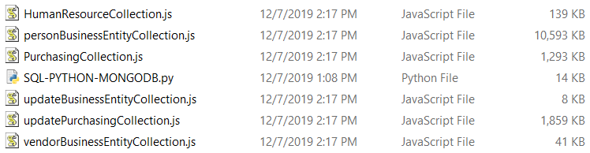

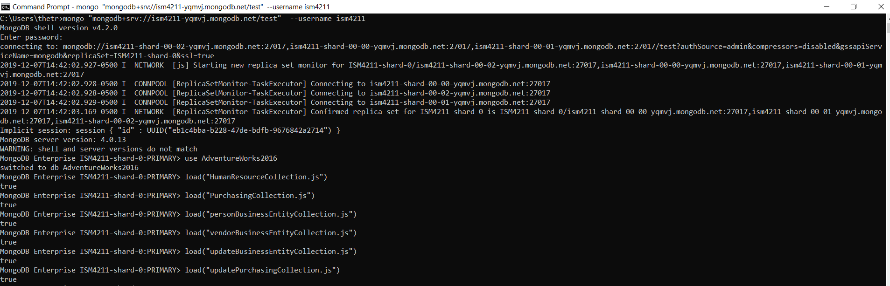
Upload Files to MongoDB Shell

Slide 15



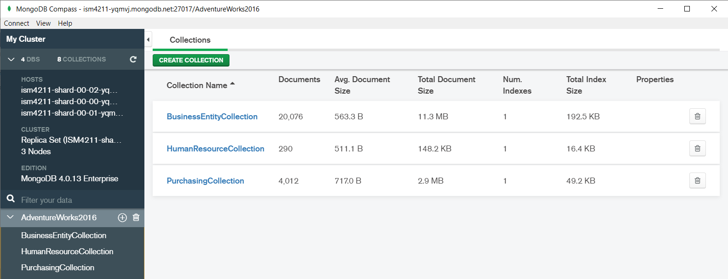
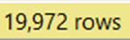
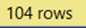
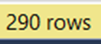
AdventureWorks2016
In
My ETL process is correct because these query results match the number of documents

Slide 16



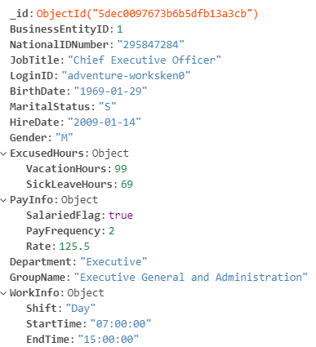
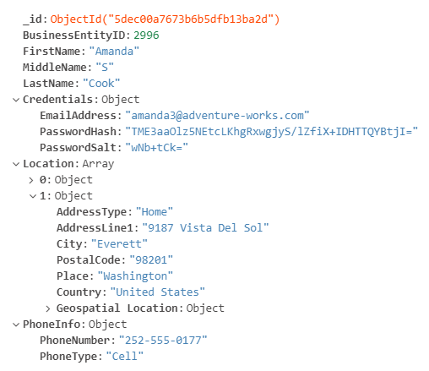
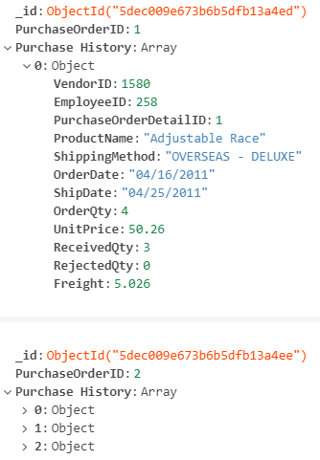
JSON Document Schema
HumanResourceCollection
BusinessEntityCollection
PurchasingCollection

Slide 17

Connect to MongoDB Compass
If using compass: mongodb+srv://<username>:<password>@ism4211-yqmvj.mongodb.net/test
If using shell: mongo "mongodb+srv://ism4211-yqmvj.mongodb.net/test" --username <username>
Username: David_Agogo
Password: ism4211
Thank you for everything Professor

